Slide 1



TEAM MEMBERS
Dharani Anthireddy
Sai Kiran Nelluru

Slide 2
Project Topic
Loan Risk Assessment using RAG
Domain and Corpus
The domain includes financial risk analysis, credit scoring, and loan approval processes.
The corpus will consist of financial regulations, credit risk datasets, loan application data, and industry reports.

Slide 3

Project Objectives
Build a RAG-based system for loan risk
assessment.
Retrieve similar case profiles, guidelines, and decisions from prior data.
Generate explainable outputs using LLMs.
Compare open-source LLM performance.

Slide 4
Value of the Project
Banking decisions often lack transparency — this system supports explainable AI.
Helps junior analysts by learning from prior loan decisions and credit policies.
Can serve as a foundation for credit risk advisory tools in fintech or microfinance.
Bridges the gap between structured financial data and natural language reasoning.

Slide 5
State of the Art in RAG
RAG Basics:
Combines retrieval (e.g., FAISS/Chroma) with generative models (LLMs).
Introduced by Lewis et al., 2020 for open-domain Q&A.
Extensively used in legal, medical, and enterprise Q&A.
Relevant Works:
Lewis et al., 2020, “Retrieval-Augmented Generation for Knowledge-Intensive NLP”.
LangChain and Haystack frameworks have enabled practical RAG applications.
Recent advances in lightweight LLMs like Mistral, Phi-3 make RAG systems feasible on local machines.
Challenges:
Domain adaptation.
Relevance scoring.
Evaluation without human label.

Slide 6




Review of State of the Art
RAG Basics
Combines retrieval with generative models.
Relevant Works
LangChain and Haystack enabled RAG
applications.
Challenges
Domain adaptation and relevance scoring.

Slide 7
Approach
LLMs:FLAN-T5-Base,LaMini-Flan-T5-248M,Falcon-RW-1B
Datasets: German Credit, Lending Club.
Preprocessing:
->Convert rows from German Credit dataset into case narratives.
->Store chunks in ChromaDB/FAISS.
Architecture:
[ User Question ]->[ Retriever ]->[ Prompt ]->[ LLM Model ]->[ Final Answer ]

Slide 8
Deliverables
Working RAG system (Notebook/App).
Case summary corpus and vector DB.
Output logs from 3 LLMs.
Comparison table of LLM results.
Final Report and Slide Deck.

Slide 9
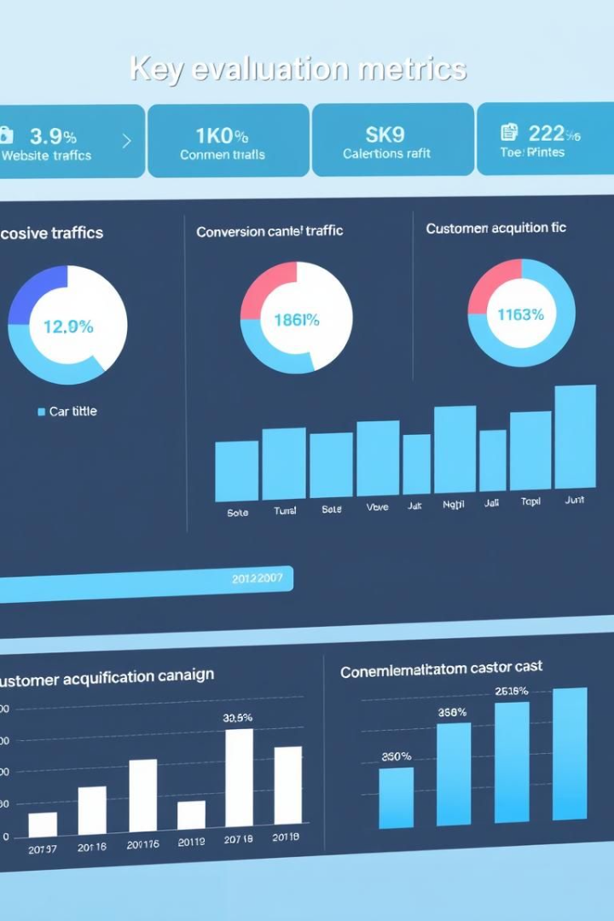
Evaluation Methodology
Relevance
Does the model use retrieved info accurately?
Correctness
Is the risk prediction consistent?
Explainability
Does the model justify the prediction clearly?
Fluency
Is the response natural and readable?

Slide 10
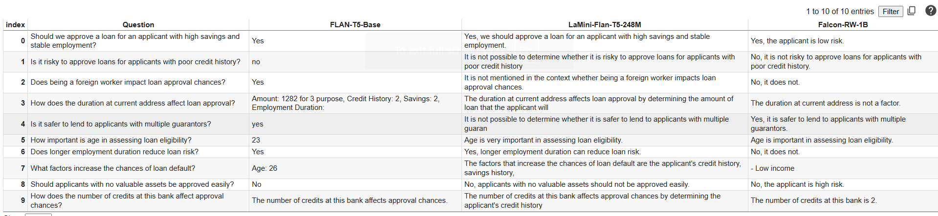
Results

Slide 11
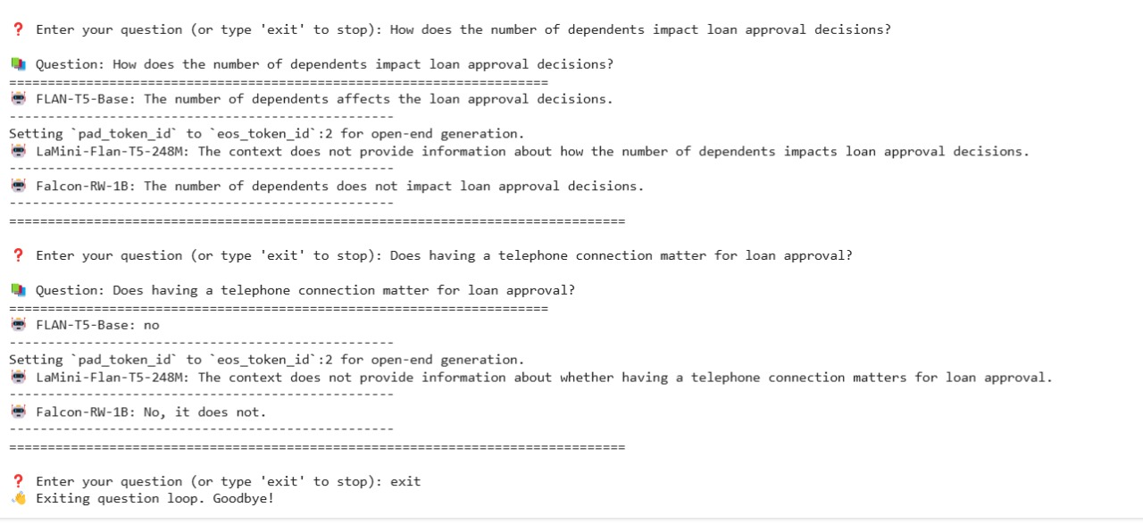
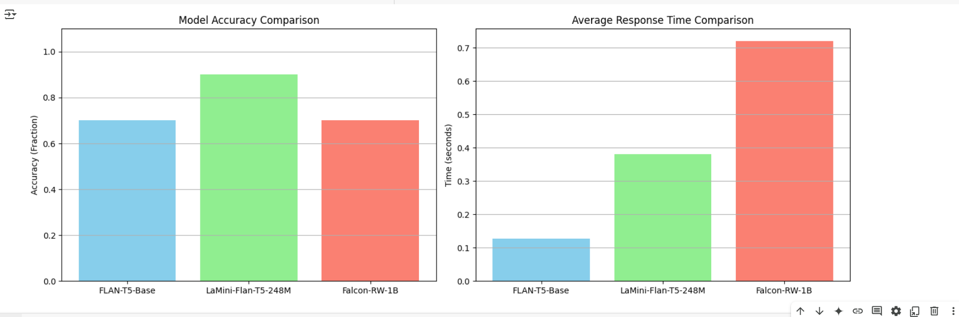

Slide 12
Conclusion
Built a Loan Risk Assessment system using RAG with German Credit case summaries stored in FAISS.
FLAN-T5-Base, LaMini-Flan-T5-248M, and Falcon-RW-1B.Compared models based on accuracy (keyword matching) and response time.
LaMini and Flan balanced accuracy and speed effectively.
RAG improved loan evaluation with smarter, context-aware answers using real case history.

Slide 13
THANK YOU

